Slide 1
A Short Introduction to Cryptography
Carsten Rudolph
Monash University
FIT1047

Slide 2
Introduction to Cryptography
What is cryptography?
Why do we need it
Look at three types of algorithms:
Symmetric encryption
Public key cryptography (asymmetric)
Hash functions for security

Slide 3
Encryption: Protect communication from eavesdroppers
Alice
Bob
Bob says:
Hello Alice!
Encrypted:
-AXFf>$g87FOPxc
Message:
Hello Alice!
Hello Alice
Evil Eavesdropper
Bob says to Alice:
Hello Alice!
????

Slide 4
Integrity: Protect communication from changes
Alice
Bob
Bob says:
I don’t like
you Alice!
Encrypted:
-AXFf>$g87FOPxc
Message:
Hello Alice!
Evil Interceptor
Changed:
XvGc76gFa23.df

Slide 5
Symmetric Cryptography
A cryptographic key is shared between two (or more) principals. Has been used for more than 3000 years.
Early example: Alphabetic substitution (we will try this in the tutorial/lab). CAESAR cipher or Vigenère cipher.
Main idea: Use the shared secret to scramble a message in a way that it cannot be understood without knowledge of the secret.

Slide 6
Encryption using Symmetric Cryptography
Alice
Message:
Hello Alice!
Bob
Message:
Hello Alice!
Encrypted:
-AXFf>$g87FOPxc

Slide 7
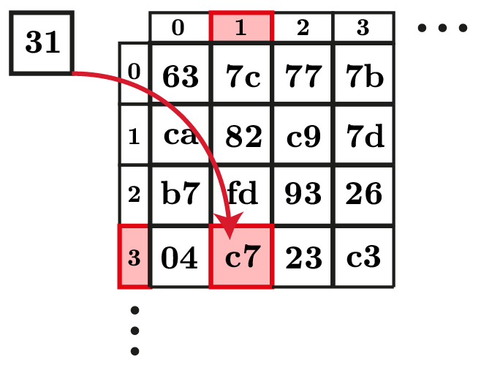
S-Boxes
Symmetric cryptography often is based on so-called S-Boxes (Substitution Boxes). They work like a look-up table for a part of the message block.

Slide 8
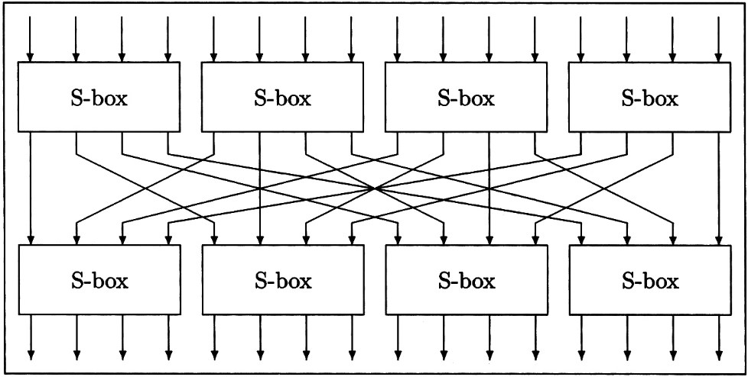
Permutations
In addition to substitutions (S-Boxes), the order of message parts is changed.

Slide 9
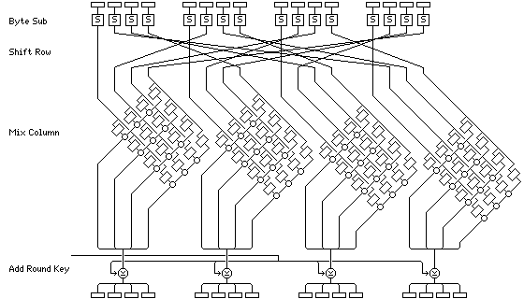
AES – Advanced Encryption Standard
AES uses 14 cycles in the 256-bit version and each round looks like this (picture shows 128-bit):
John Savard, www.quadiblog.com

Slide 10
A modern Algorithm for Symmetric Cryptography: AES
Open selection process by NIST (National Institute for Standards and Technology, U.S.)
15 designs were submitted
Winner was announced in October 2000
Rijndael developed by two Belgian cryptographers (Joan Daemen and Vincent Rijmen) was chosen to become AES

Slide 11
Security Properties of Symmetric Encryption (AES)
AES works on message blocks. It provides confidentiality. Integrity is not straightforward (e.g. change order of blocks, change bits etc.)
Different types of block chaining
Start with an initialization vector and then combine each encrypted block with the next block. Thus, blocks in wrong order cannot be decrypted and a changed block will disable decryption of next bock.

Slide 12
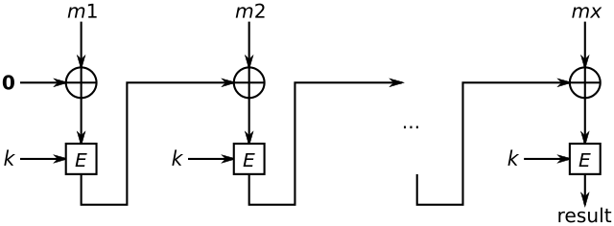
WPA2/CCMP uses AES and a CBC-MAC
CBC – Cipher Block Chaining
MAC – Message Authentication Code
Result is one block that can be used to check integrity of the complete message: m1 m2 ….mx

Slide 13
Disadvantages of Symmetric Cryptography
Symmetric cryptography is very efficient, but has a number of disadvantages:
Key distribution: somehow, one needs to establish a shared secret. An alternative secure channel for key distribution is necessary.
Scalability: Each pair of sender and receiver needs a unique secret key. The number of keys grows exponentially with the number of participants (12 participants need 66 keys, 1000 need 499,500 keys and a million participants need an unrealistic 499,999,500,000 keys)

Slide 14
Public Key Cryptography
In the early 1970s cryptographers developed the idea of “non-secret encryption”.
First (public) practically usable schemes were developed in 1976 by Diffie and Hellman (influenced by Merkle) (known as Diffie-Hellman Key Exchange) and in 1978 by Rivest, Shamir and Adleman (known as RSA).
General idea: Based on a “hard“ mathematical problem and a large random number, a key-pair is generated, such that the private key cannot be derived from the public key without solving the underlying mathematical problem. Every principal owns a unique pair of keys.

Slide 15
Encryption using Public Key Cryptography
Alice
Message:
Hello Alice!
Bob
Message:
Hello Alice!
Encrypted:
356jK$^klmGxL1dF

Slide 16
Key Establishment using Public Key Cryptography
Alice
Alice
Alice
Shared Secret
Key derivation
using both keys
Bob
Bob
Bob
Shared Secret
Key derivation
using both keys

Slide 17
Digital Signatures / Authenticity
Alice
Alice
Alice
Message: I agree!
Signature: 147JkX78GhC
Message: I agree!
Sign message
using private key
Bob
Message: I agree!
Alice’s signature is verified.
Verify signature
using public key

Slide 18
Other Uses of Public Key Cryptography
Based on the basic mechanisms, many cryptographic protocols and security applications have been developed.
Some examples:
electronic cash
non-repudiation protocols
fair exchange protocols
electronic voting
multi-party key agreement

Slide 19
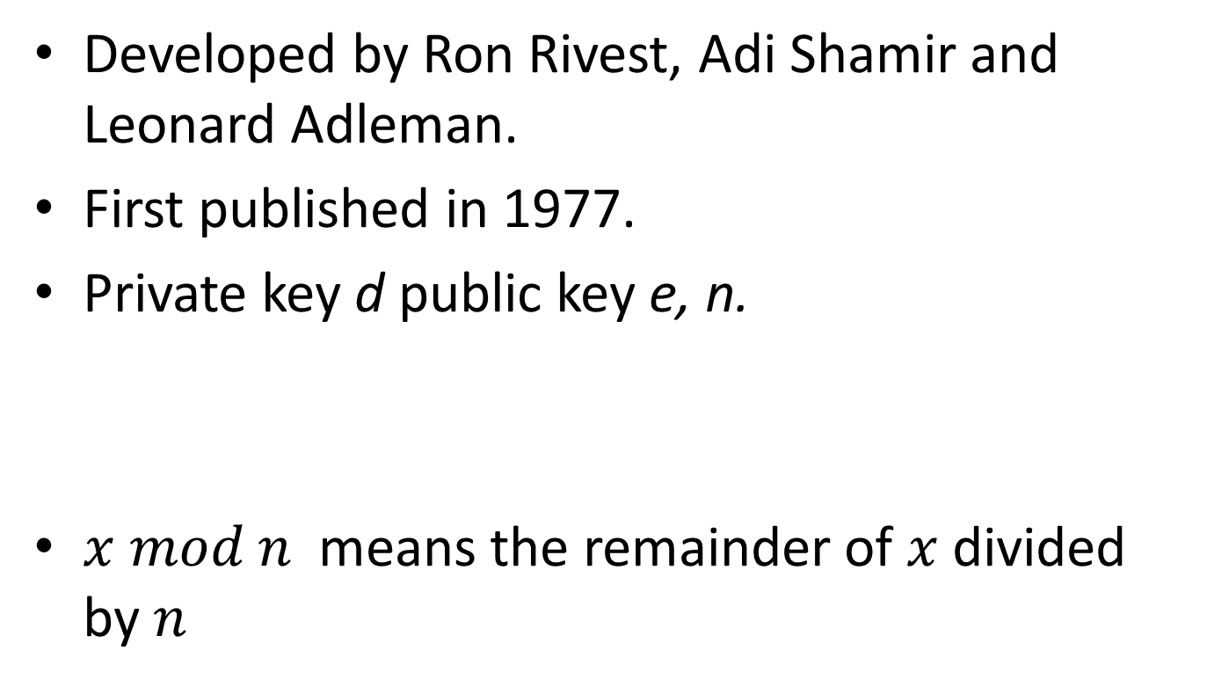
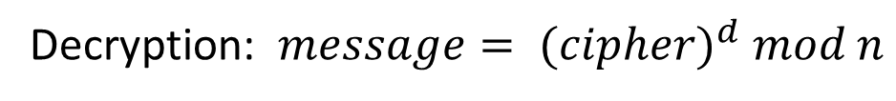
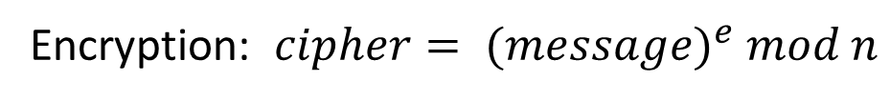
Example for asymmetric cryptography: RSA
Developed by Ron Rivest, Adi Shamir and Leonard Adleman.
First published in 1977.
Private key d public key e, n.
$x mod n$ means the remainder of $x$divided by $n$
Encryption: $cipher= {(message)}^{e} mod n$
Decryption: $message= {(cipher)}^{d} mod n$

Slide 20
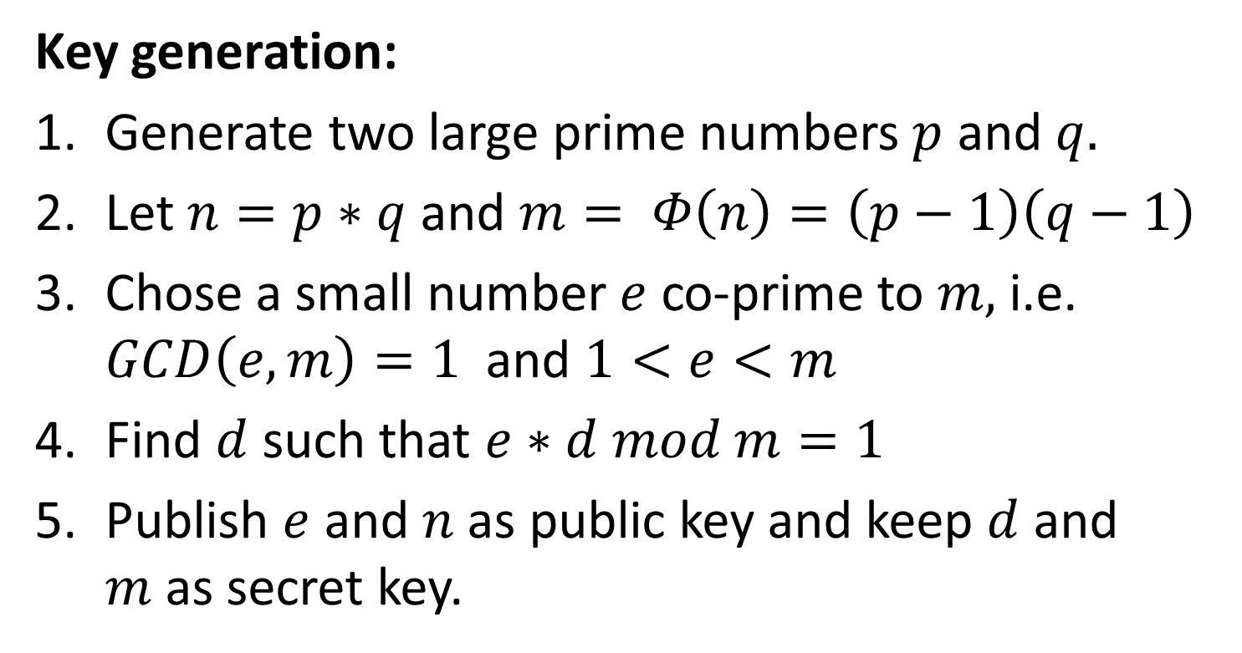
RSA in a bit more detail
Key generation:
Generate two large prime numbers $p$ and $q.$
Let $n=p∗q$and $m= Φ\left(n\right)=\left(p−1\right)\left(q−1\right)$
Chose a small number $e$ co-prime to $m,$ i.e. $GCD\left(e,m\right)=1$ and $1<e<m$
Find $d$ such that $e∗d mod m=1$
Publish $e$ and $n$ as public key and keep $d$ and $m$as secret key.

Slide 21
Random numbers
All types of cryptography need random numbers for
Key generation
Use in protocols to mark messages as new
Initialisation vectors
Many attacks on cryptography have been based on bad random numbers.

Slide 22
Cryptographic hash functions
A hash function maps input of arbitrary length to a fixed length output.
Cryptographic hash functions are infeasible to invert.
Used in digital signatures, for storing and comparing passwords, in message authentication codes, etc.

Slide 23
Ideal cryptographic hash functions
Need to have the following properties:
Computing a hash value for a message needs to be fast and use low resources.
Given just a hash, it is infeasible to find the original message (except by trying all possible messages)
Hashes for similar messages should not be correlated (small change in message -> large change in hash)
Infeasible to find collisions (i.e. two messages with the same hash).

Slide 24
Some Hash functions
MD5 was widely used, but is not secure. Sometimes it is still used for integrity protection.
SHA1 is better, but attacking it is much easier than brute-force. Attacks get more efficient. Is no longer recommended for digital signatures.
Current recommendations are SHA-256, SHA-384 and SHA-512

Slide 25
Go to mars.mu
Join the feed: ZE0X4V

Slide 26
What would you use if you want to protect the integrity of a message?
RSA
MAC
SHA-256
SHA-1
Feed: 8G407T

Slide 27
What would you use if you want to protect the integrity of a message?
RSA Plain RSA does not protect integrity. Ciphertext can be multiplied and then decrypted.
MAC
SHA-256
SHA-1
Feed: 8G407T

Slide 28
What would you use if you want to protect the integrity of a message?
RSA
MAC
SHA-256
SHA-1 Hash functions can be used to check if some data has changed. However, hash functions are publicly known. Thus, the attacker can just calculate a new hash for the manipulated message!

Slide 29
What would you use if you want to protect the integrity of a message?
RSA
MAC A key is required to compute a valid message authentication code. If the attacker does not know the key, she cannot create a MAC for a changed message. Thus, it can protect the integrity of a message.
SHA-256
SHA-1

Slide 30
Which mechanism is more secure to provide confidentiality?
Symmetric cryptography
Public key cryptography
Depends on the actual algorithm and security parameters (e.g. key length)
Feed: 8G407T

Slide 31
Which mechanism is more secure to provide confidentiality?
Symmetric cryptography
Public key cryptography
Depends on the actual algorithm and security parameters (e.g. key length)
Feed: 8G407T

Slide 32
Recommended key lengths
AES (symmetric): Currently, 128 bit is considered secure. Long term recommendations (after 2030) go towards 256 bit.
RSA (public key): Currently, 2048 bits is considered secure. Some agencies/government bodies recommend 3072 bits after 2020, others after 2030.
Recommendations from NIST, NSA and the German BSI differ in details.

